Slide 1
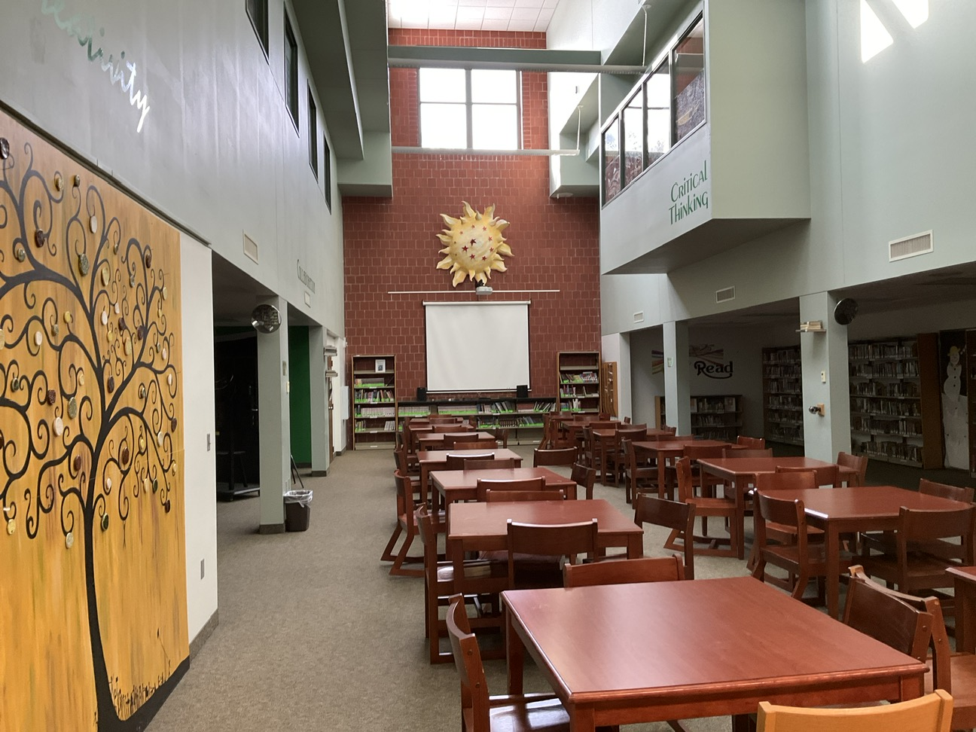
Pine city high school
Virtual tour

Slide 2
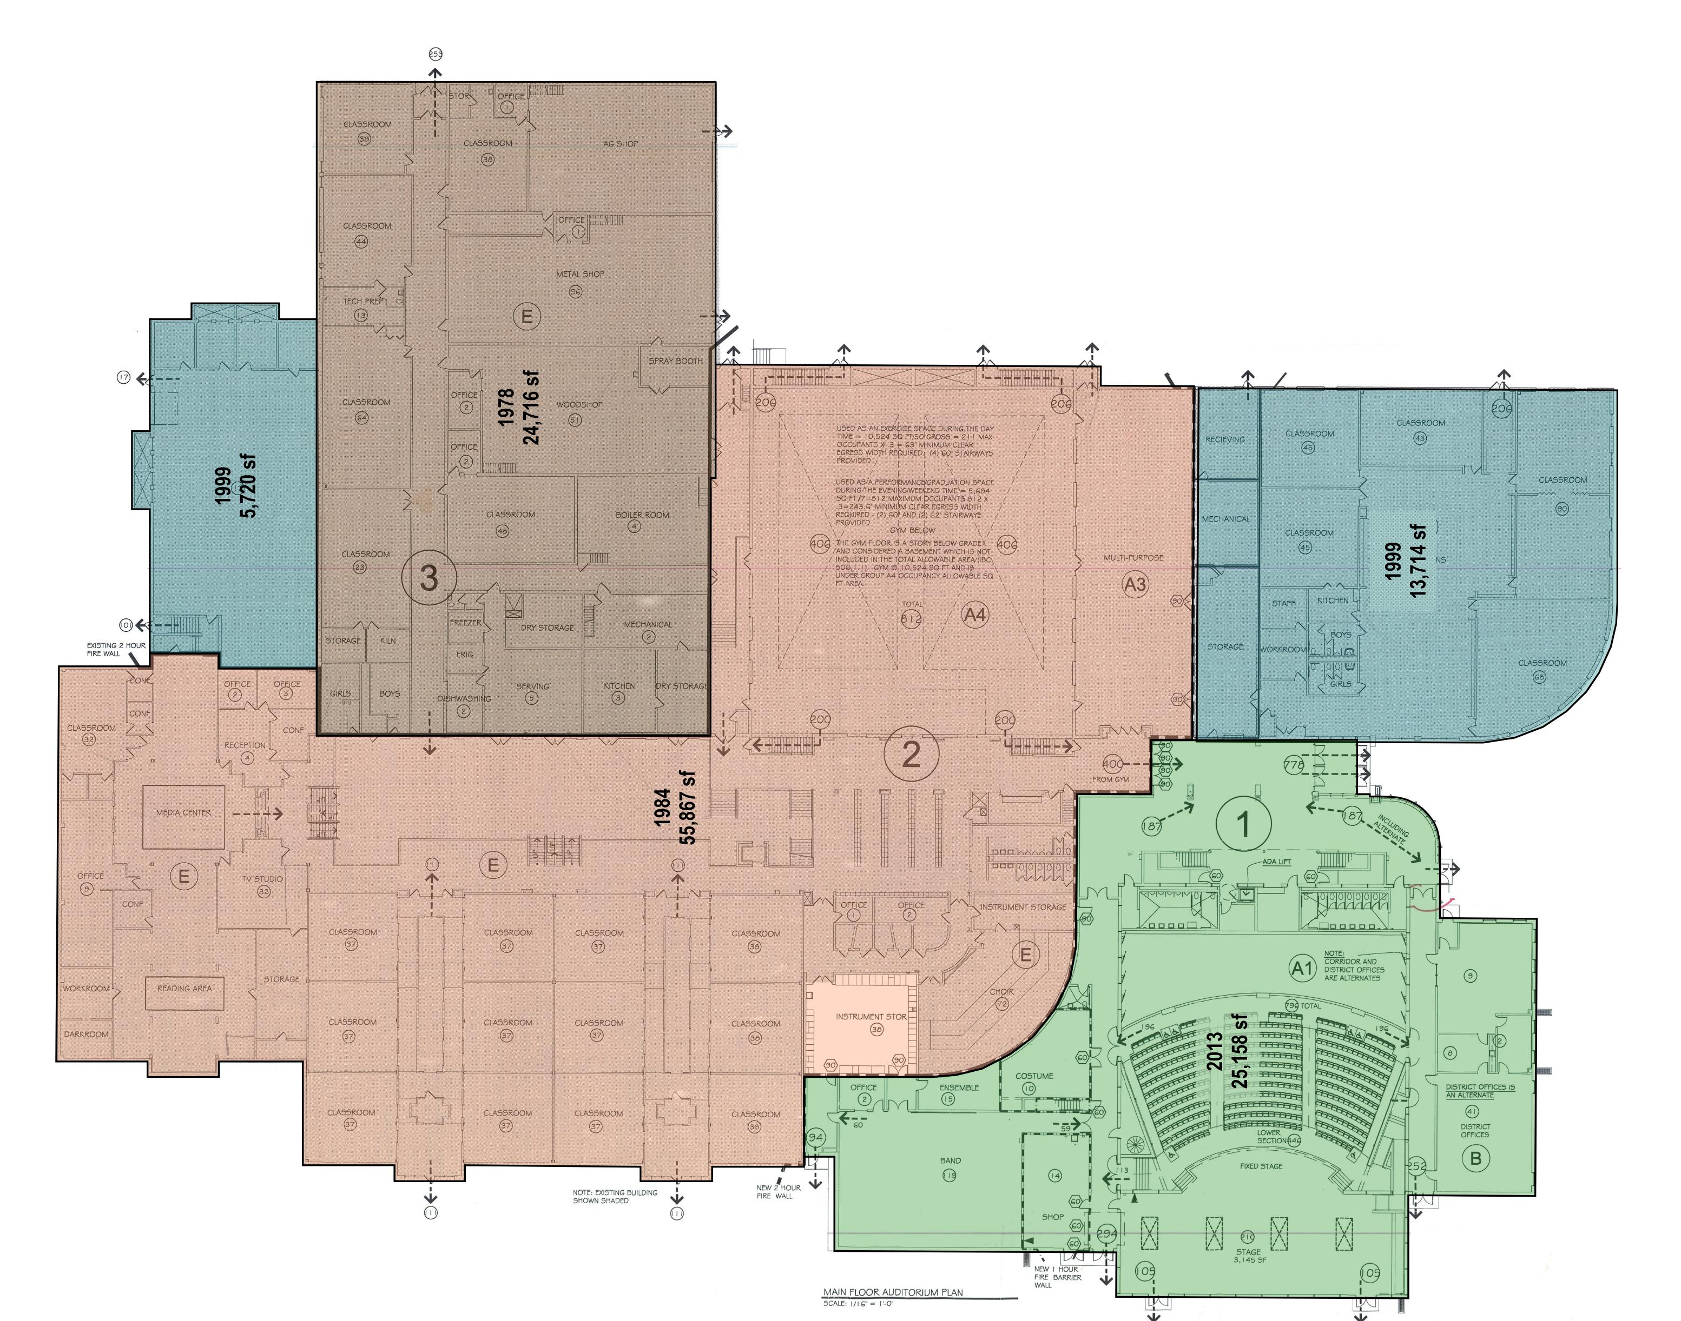

Slide 3
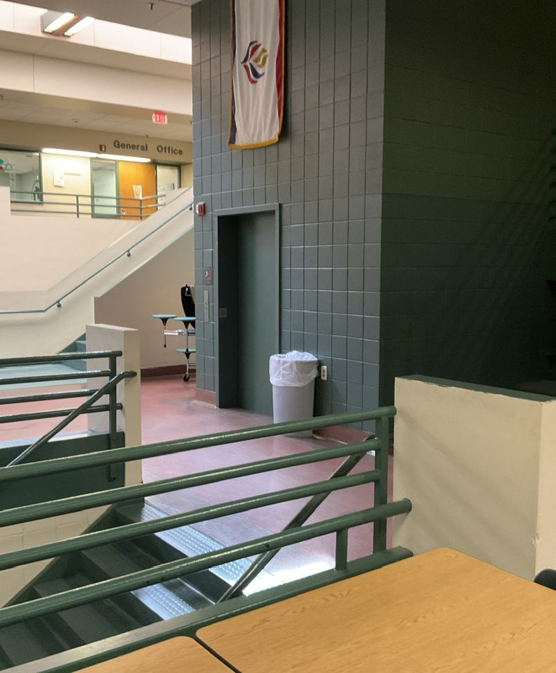
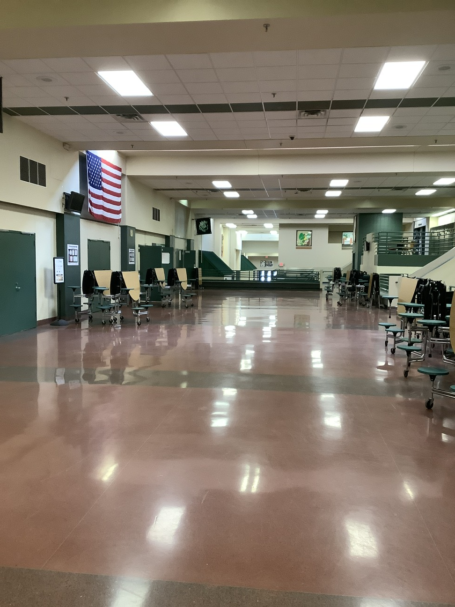
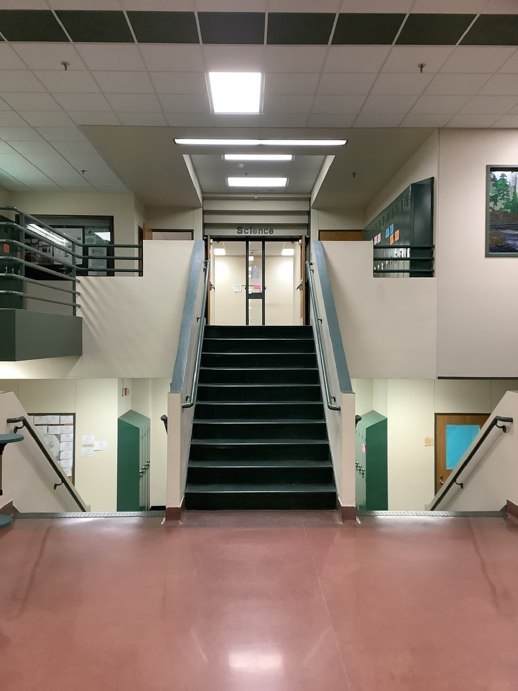
Cafeteria / common space
Overall Cafeteria
Elevator
Stairs

Slide 4
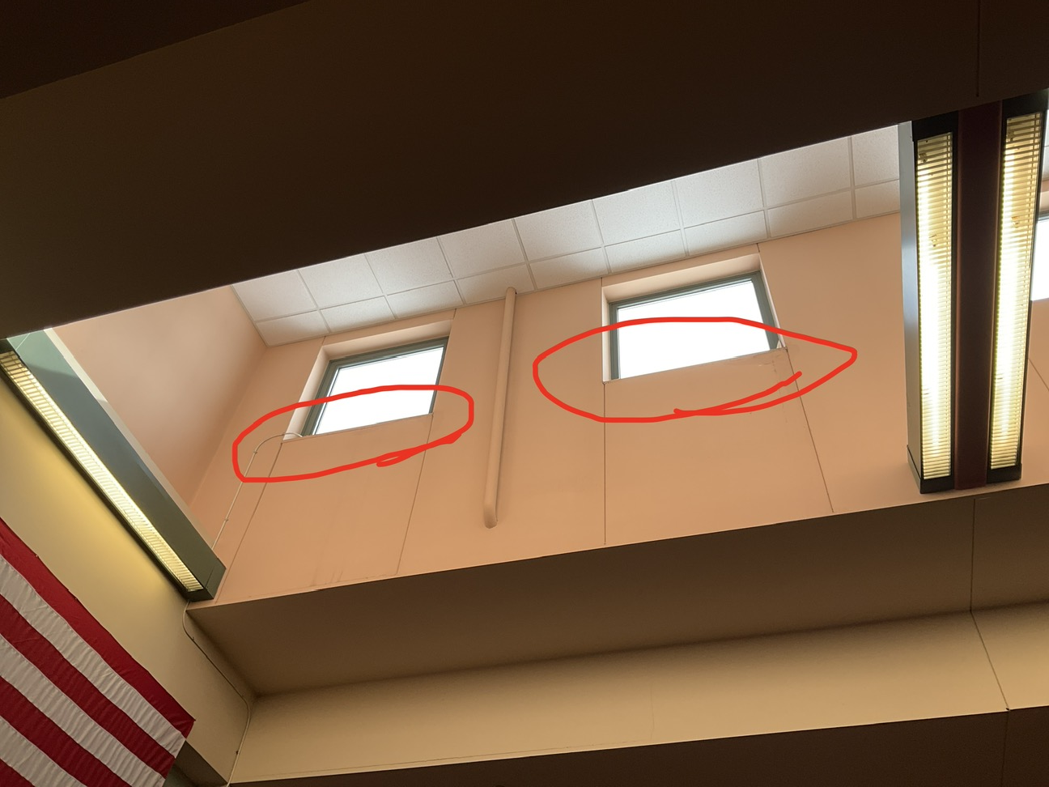

Slide 5
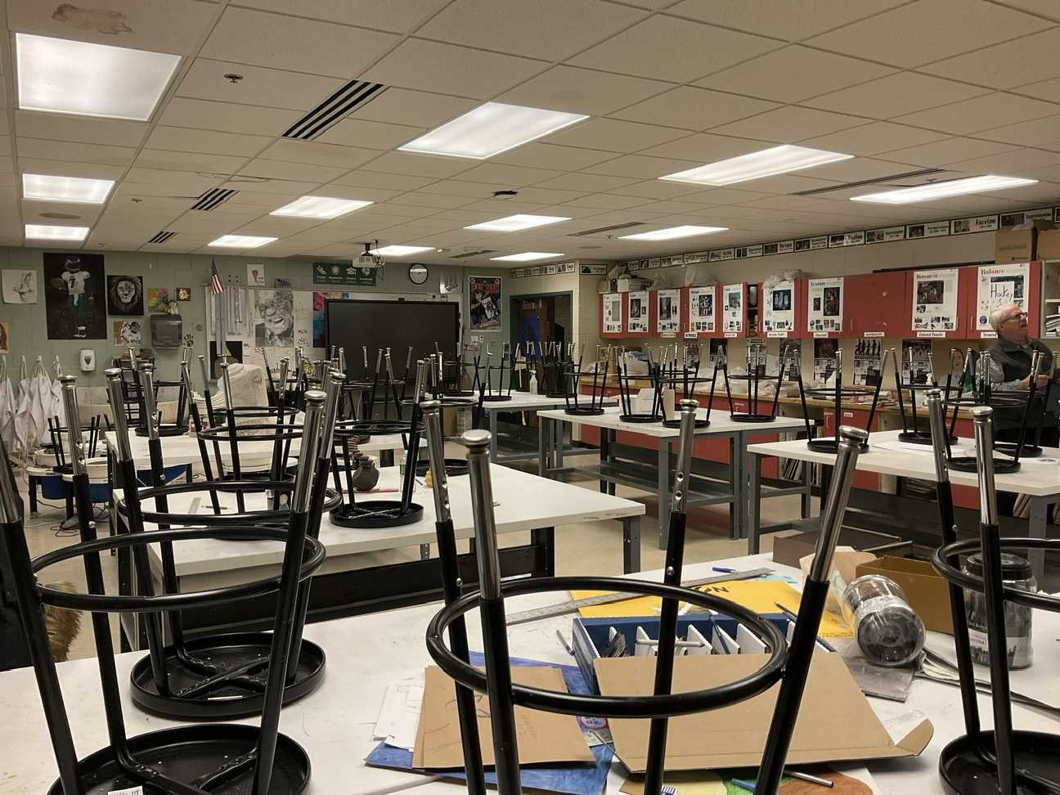
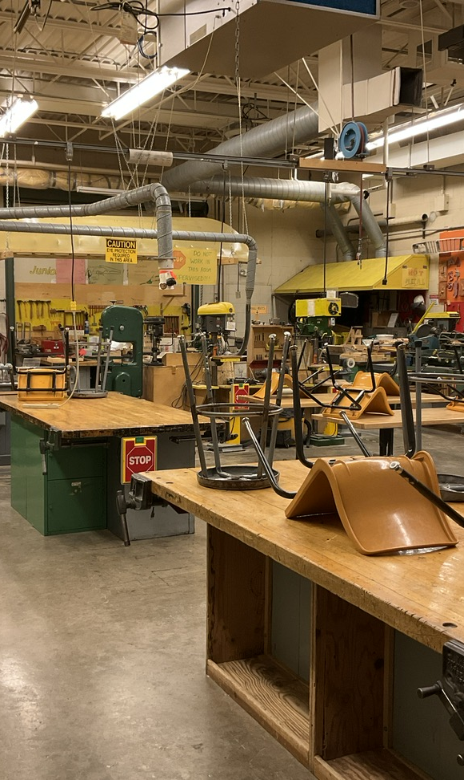
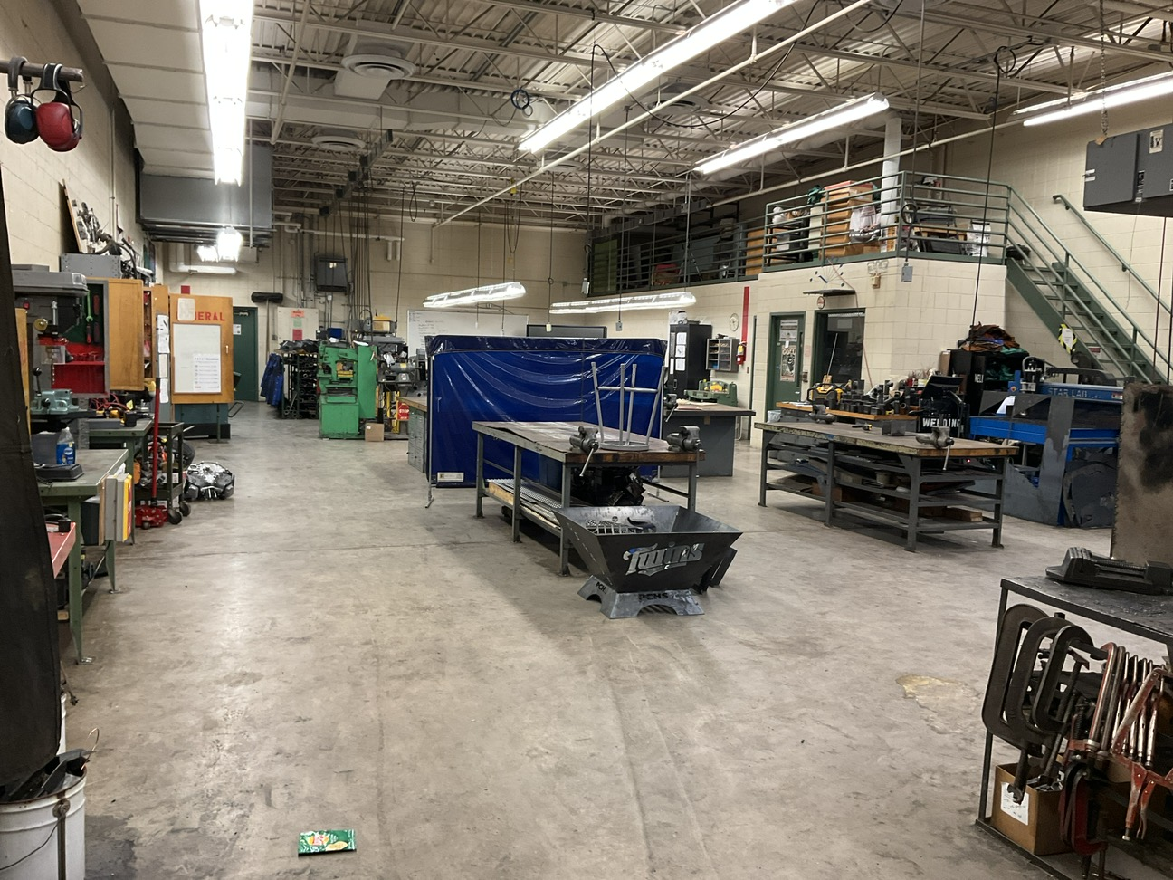
Lab spaces
Are lab spaces meeting the needs of the students?
Square feet devoted to lab space
Technology integration
Synergy with ALC

Slide 6
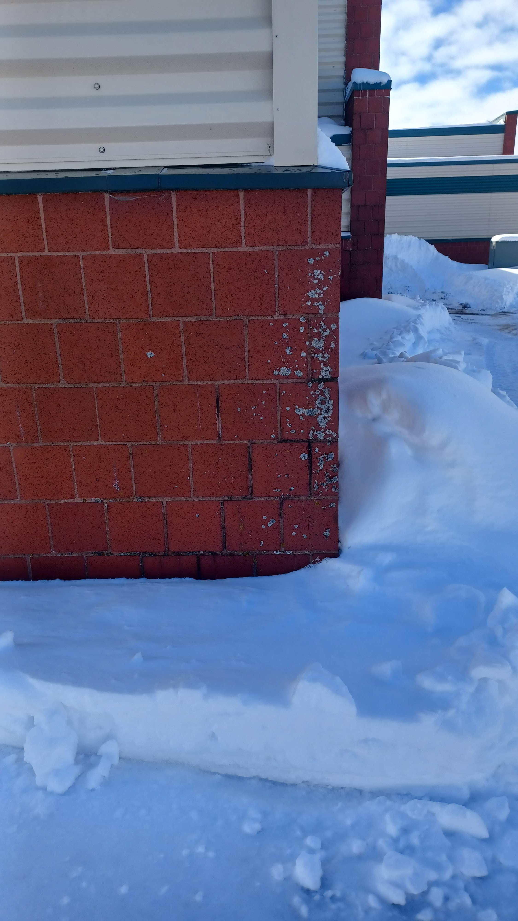
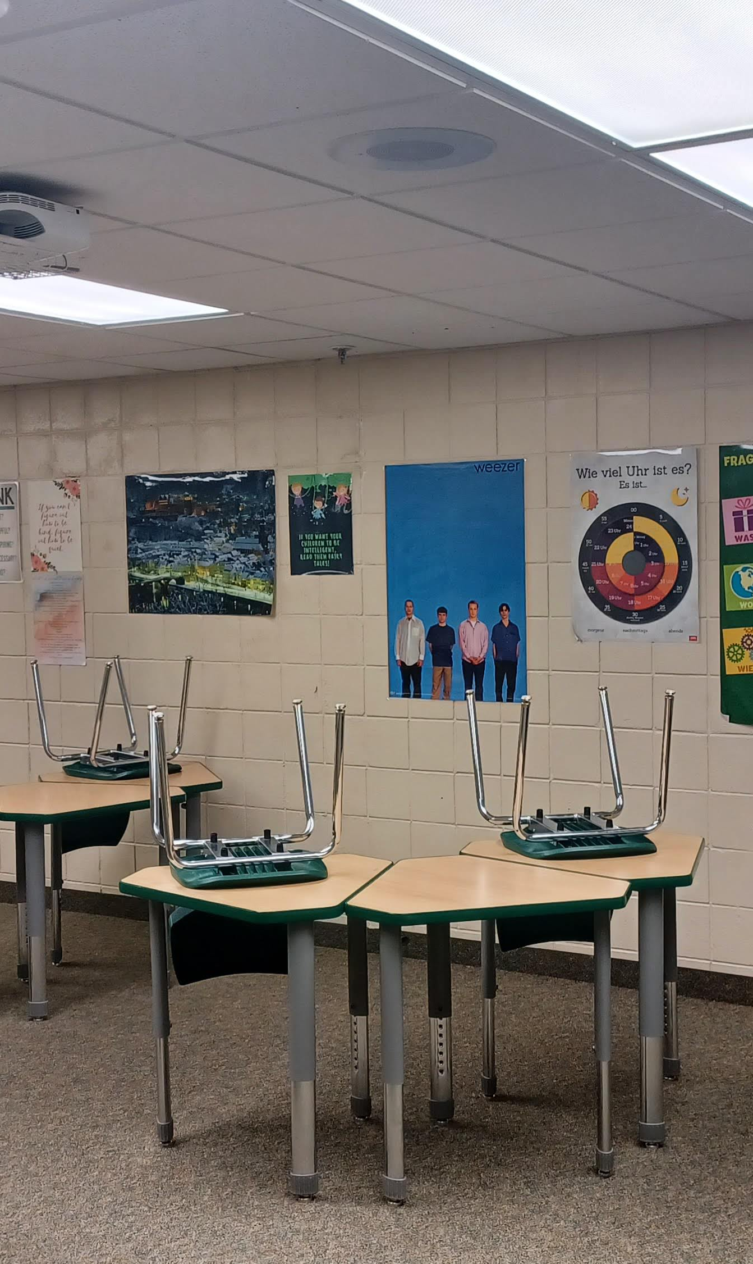
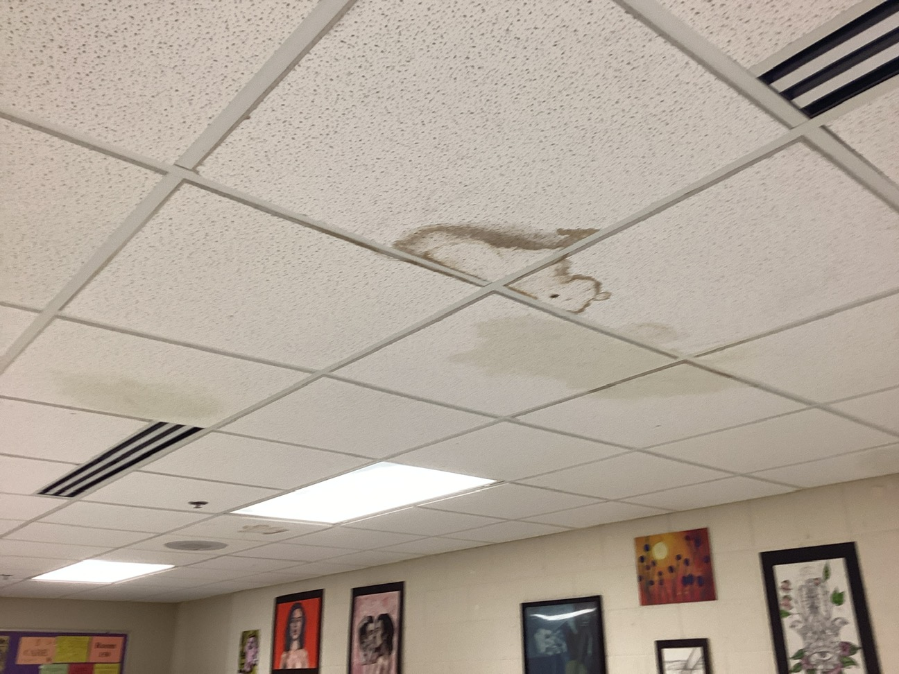
north classroom water leakage
North foundation wall leaks
Water leaks from classroom above
Water leaks at north wall when it rains
Water leaks through plumbing penetrations in floor above
Unsightly ceiling tile
Temporary collection system
Peeling paint, discoloration, efflorescence
Potential indoor air quality issue

Slide 7
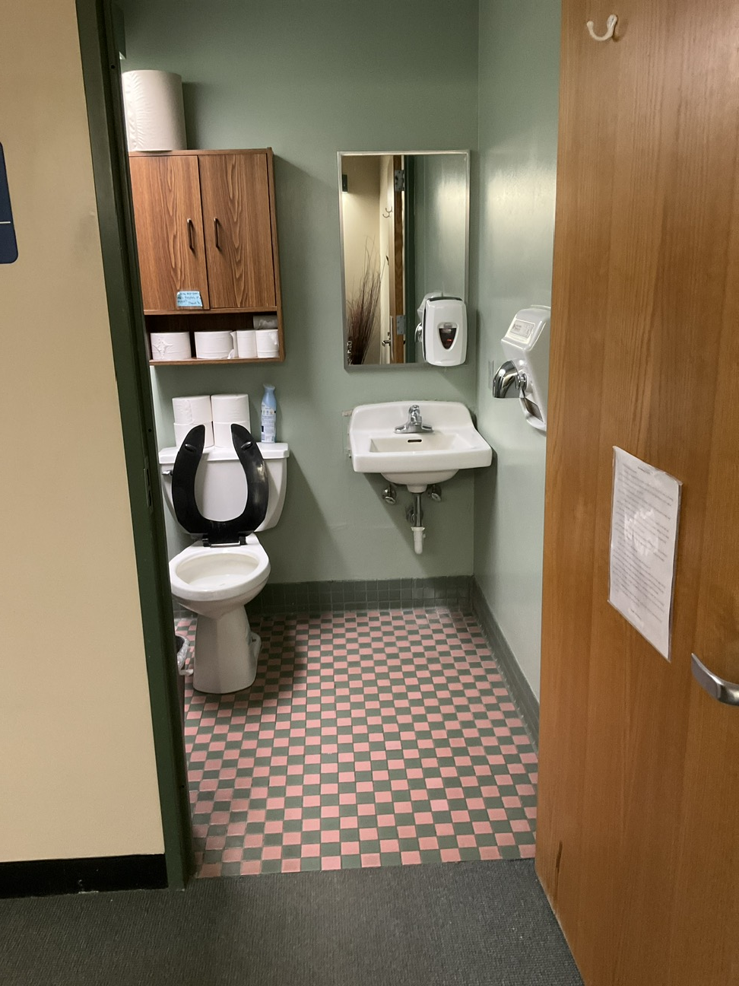
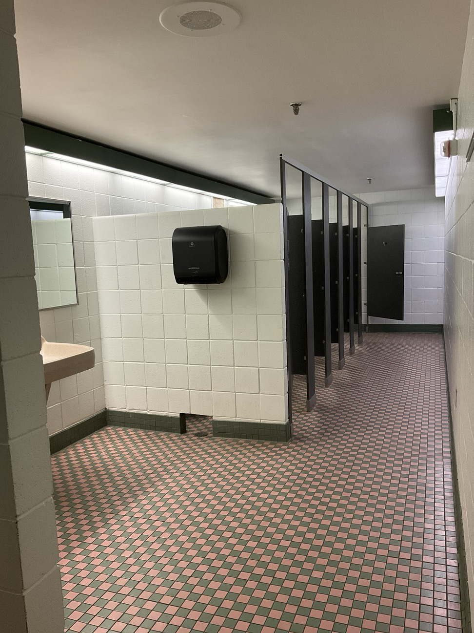
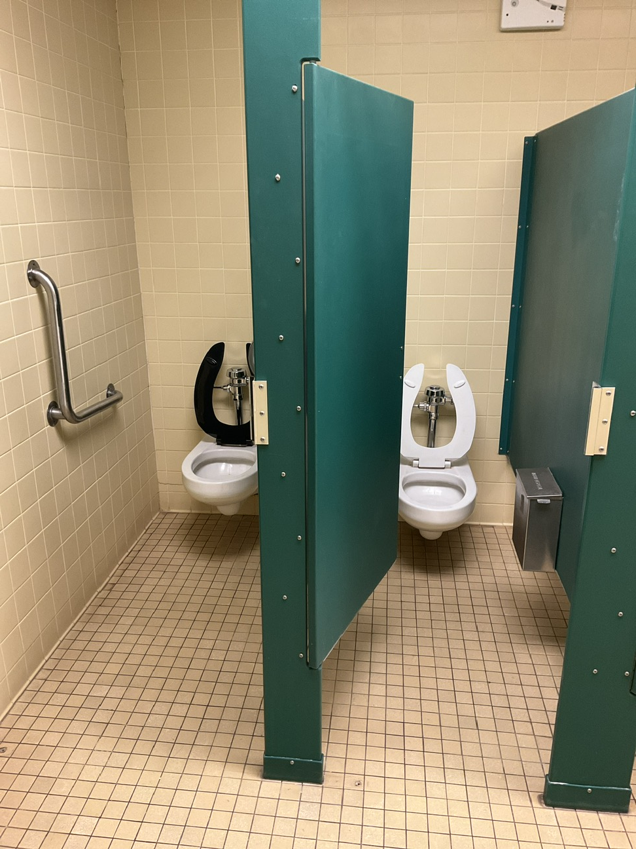
restrooms
Most restrooms do not meet accessibility requirements.
No accessible restrooms on the lower level or cafeteria level, or upper level
Accessible restrooms on main level are at auditorium lobby
Six single user restrooms, most not accessible to students or public. Only two meets accessible requirements, only one is public

Slide 8
Media center

Slide 9
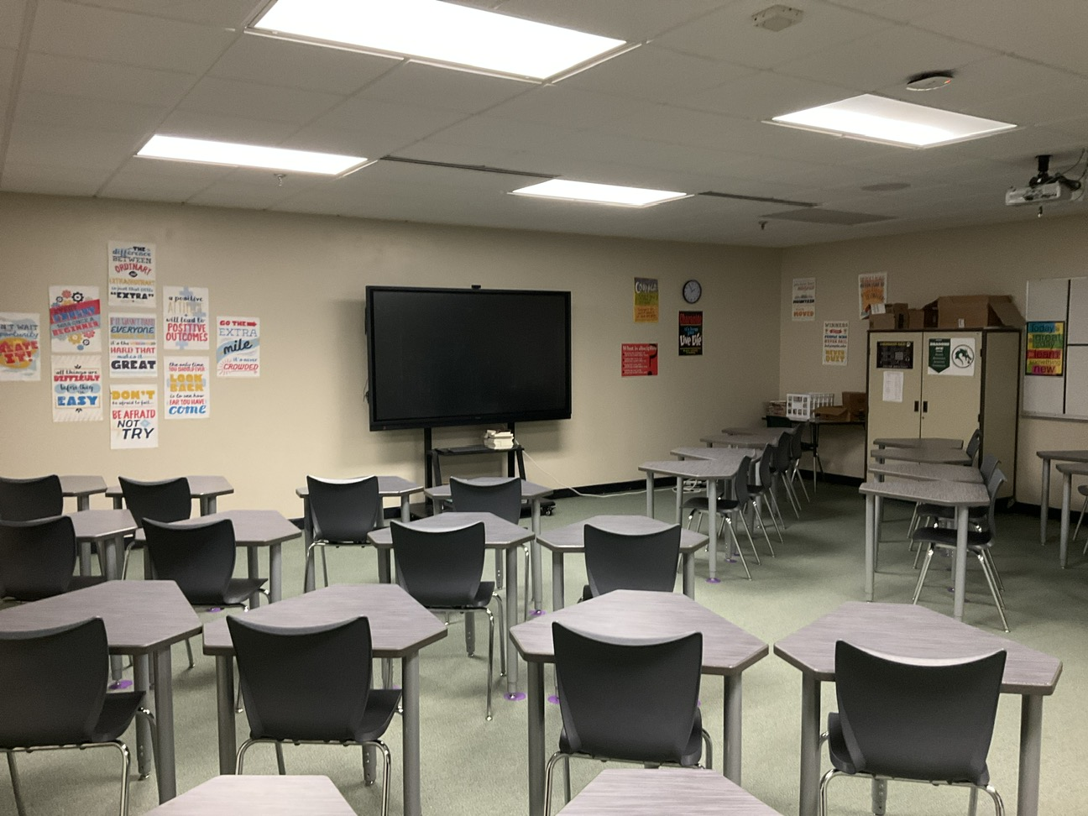
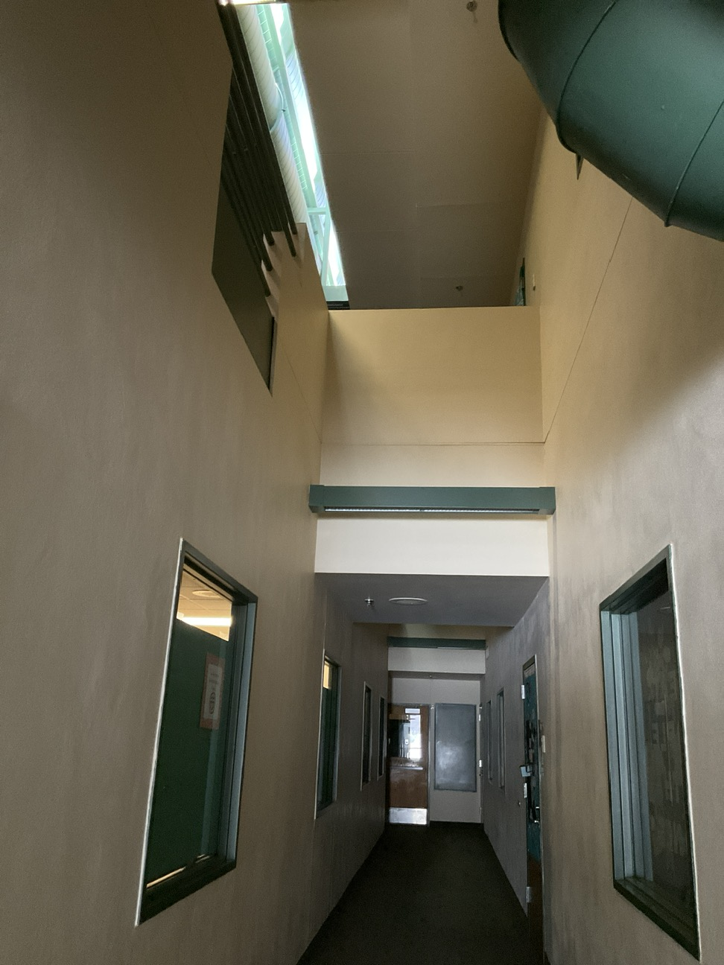
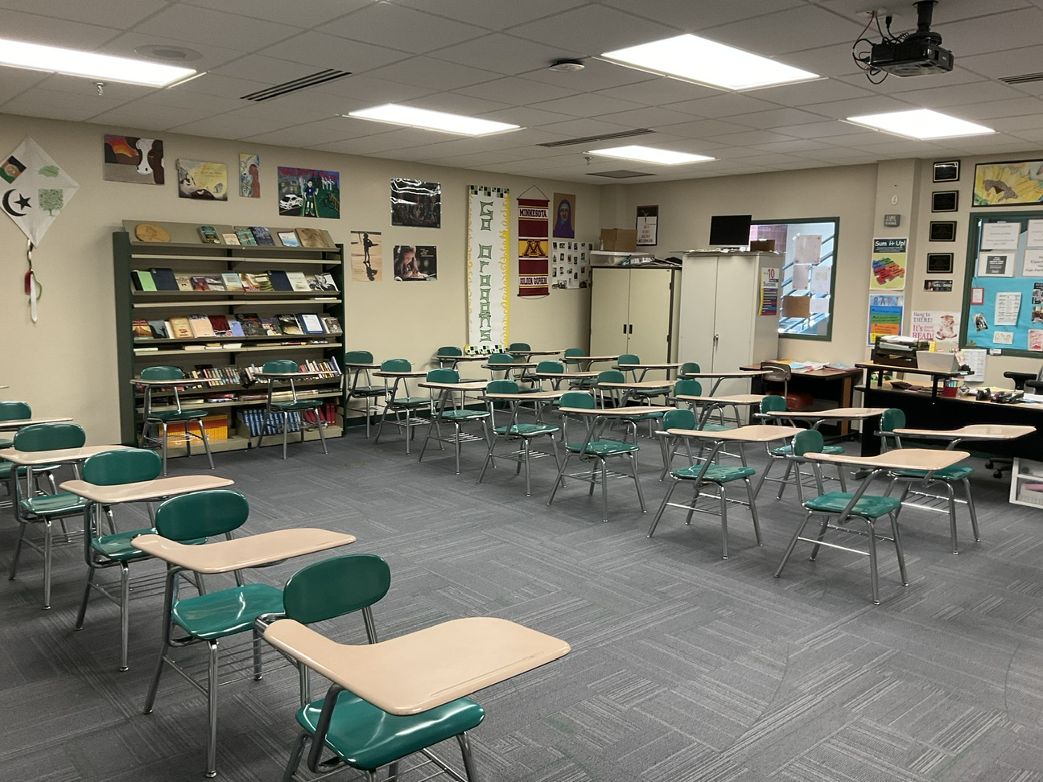
Classroom spaces
Most classrooms do not have access to daylight.
Traditional classroom layout
Two-story spaces in SPED area are disruptive to students
Clerestory windows were mostly blocked by new mechanical system

Slide 10
THANK YOU!

