Slide 1
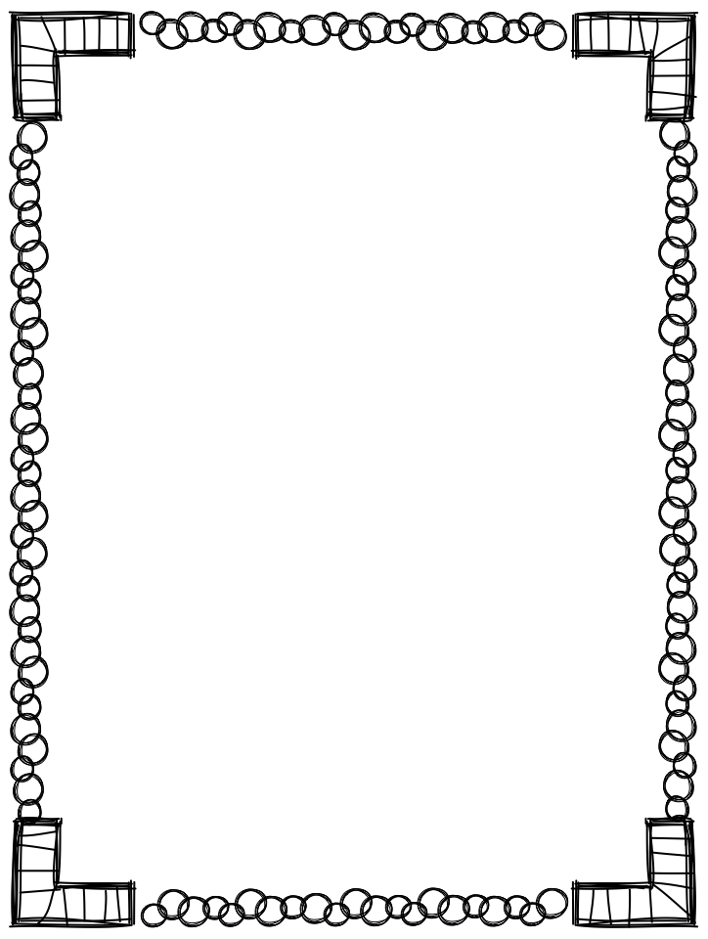





Welcome to ENL!
NYSESLAT
What is it?
The NYSESLAT is a state test that has 4 components; reading, writing, speaking and listening.
The test is administered between April 9, 2018 and May 18, 2018.
It is very important the students get a good nights rest and breakfast before test days.
It is important to practice at home to prepare for the test by encouraging meaningful conversations.
Raz kids
What is it?
Raz-Kids is a great program that provides leveled reading resources for students.
Every text is available online and through your phone (app), that allows students to listen to and read at their own pace, as well as record themselves reading.
Spanish text and quiz translations for ELLs and bilingual programs.
Visit: www.kidsa-z.com

