Slide 1
Course selection
2022-2023
Current junior class

Slide 2

Who is my counselor?
Mr. Ball A – E
Mrs. McKenna F – Lar
Mr. Sheehan Las - Q
Mrs. Stenberg R – Z
Mrs. Lujano (504 Counselor A-Z, IEP P-Z)
Mr. O’Connell, DC (IEP Counselor A-O)
Mrs. Applehans College and Career Center
Mrs. Feeney Counseling Department Secretary

Slide 3

course selection information
Students will register for classes through their Knights Block. Appointment times will be sent to students and posted throughout the building.
Please continue to check your email for updates regarding course selection.

Slide 4
Things to consider - Balance is key!
Do I have enough time to be successful in all of my courses?
Do I have enough time to be involved in extracurricular activities or get a job?
Have I discussed my course selections with my parents/guardians?
Have I thought about my future goals/career interests?
Will I have enough time to apply to college?

Slide 5

Things to consider
You will need to select enough classes to fill 7 periods.
Lunch and Knights Block will be built into your schedule.
Please think about a few back up elective options in case your first choice is unavailable.

Slide 6
recommendations
Your current teachers have made recommendations in many departments so you may be placed in English, Math, Science, Social Studies and World Language based on these recommendations.
All Seniors will take one semester of Government - Regular/Honors/AP

Slide 7

reminders
All Seniors will take an Economics class or Personal Finance to meet their consumer education requirement if they have not done so yet.
PE choices - pick a first and second choice.
Electives - pick a first and second choice.
Have you completed your Fine Arts?
Have you completed your Applied Arts?

Slide 8

Examples of electives
Fine Arts: Music/Band, Theatre, Visual Arts
Applied Arts: Business Education, Family and Consumer Science, Technology and Engineering
Consumer Education: Personal Finance, Economics, AP Economics
World Languages: Spanish and French
Life Fitness: Team Sports, Individual Sports, Strength & Conditioning, Aerobics and Conditioning, Adventure Challenge, Dance 1 & 2

Slide 9

Tech campus information
Tech Campus is open to Juniors and Seniors
If you are interested in attending Tech Campus - Talk to your counselor
Note: Tech Campus is 4 periods long; 2 periods each day so it may be difficult to fit into your schedule
To view the programs that are offered at tech campus go to https://www.techcampus.org/

Slide 10
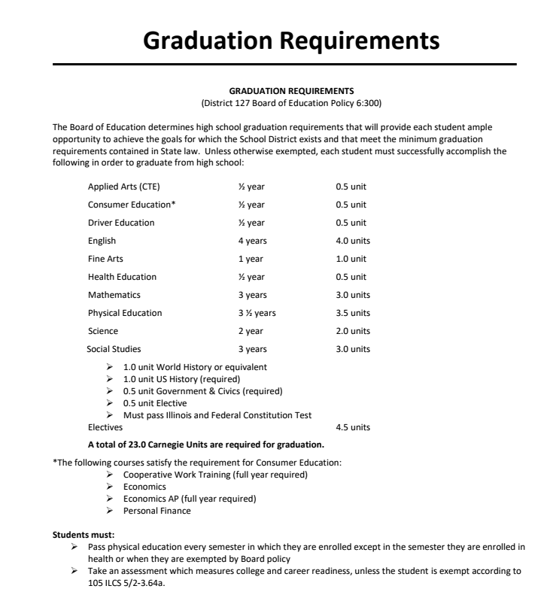


Slide 11






How do I make an appointment with my counselor?
https://kball-gnhs.youcanbook.me/ https://vlujano.youcanbook.me/ https://jmckennagnhs.youcanbook.me/ https://tim-sheehan.youcanbook.me/
https:// https://poconnell.youcanbook.me/ https://mstenberg.youcanbook.me/

