Slide 1
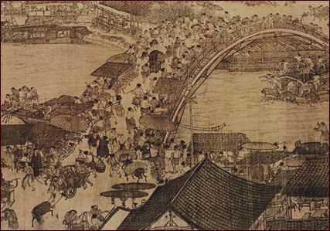
China: Tang and Song Dynasties
After it falls, what impact does a civilization have on history?
Do belief systems unite or divide people?

Slide 2
The Main Idea
During Tang and Song rule:
  China had a strong central government and a strictly ordered social structure based on Confucianism.
  The economy was strong.
  There were great achievements in the arts and architecture. The most advanced society in the world!
  China influenced other cultures, including that of Japan.

Slide 3
Rise and Fall of Dynasties: Tang Dynasty (618-907 AD)
After the Han Dynasty declined, China was divided for nearly 400 years, but remained strong
In the 600s, Tang Dynasty builds a vast empire
Tang rulers force Vietnam, Korea, and Tibet to become tributary states
  States remain independent, but their rulers had to acknowledge China’s greater power and send tribute (regular payment)
Tang Dynasty collapses in 907
  Caused by government corruption, drought, rebellions

Slide 4
Rise and Fall of Dynasties: Song Dynasty (960-1279 AD)
China prospered under Song rule (Golden Age)
  Rapid population growth due to prosperity and new type of rice grown by farmers
  China becomes most urbanized country in the world
Song Dynasty is weakened by invaders and is finally conquered by the Mongols

Slide 5
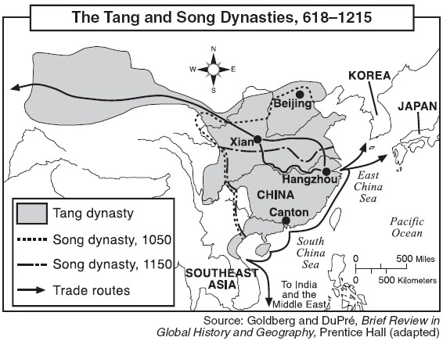
Rise and Fall of Dynasties

Slide 6
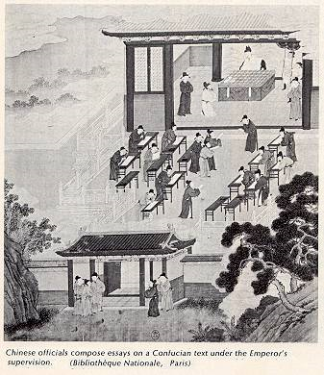
Government and Society
Government and structure of society guided by Confucius beliefs such as filial piety (respect for parents/elders)
Confucian thought stressed social order based on duty, rank, and proper behavior

Slide 7
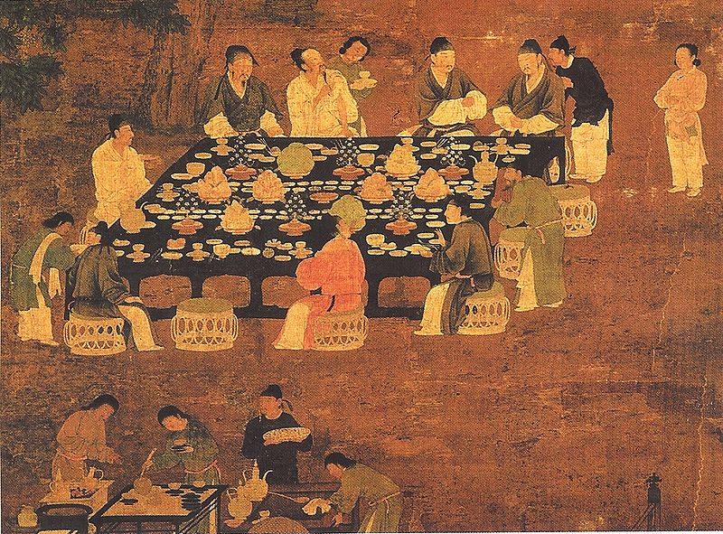
Government
Tang rulers use the civil service system
  People who wanted to hold office had to pass difficult examinations that emphasized Confucian philosophy
  Schools are built to prepare men for the exam
  Creates a highly educated ruling class
Notes:
Picture: An Elegant Party, an outdoor painting of a small Chinese banquet hosted by the emperor for scholar-officials from the Song Dynasty (960-1279). Although painted in the Song period, it is most likely a reproduction of an earlier Tang Dynasty (618-907) work of art. The painting is attributed to Emperor Huizong of Song (r. 1100–1125 AD).

Slide 8
Strict Social Order
Gentry
Wealthy landowners study Confucian ideas
Some become civil servants
Peasants
Majority of population
Farmers work the land and live in small villages
Merchants
Some become very rich
Lower status than peasants because their riches come from work done by other people
Some buy land and educate a son so he can join the gentry

Slide 9
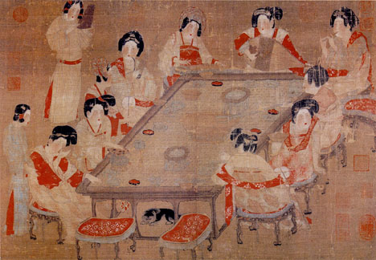
Status of Women
Women held great authority
In the home, women managed family finances, imposed discipline, and supervised servants
However, boys were still valued over girls and when women married they became part of their husband’s family

Slide 10
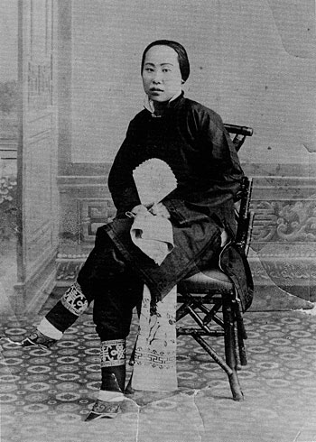
Status of Women
Footbinding
Feet of young girls were bound with strips of cloth to prevent the feet from growing normally
Tiny feet became a symbol of nobility and beauty
Extremely painful and can’t walk without help
Spreads to even the lower classes
Reinforces the Confucian tradition that women should remain inside the home

Slide 11
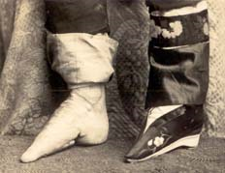
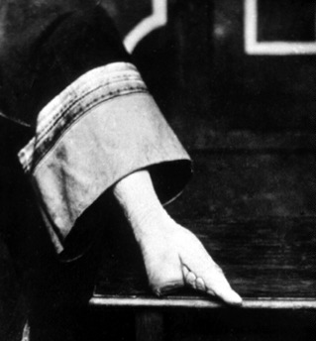
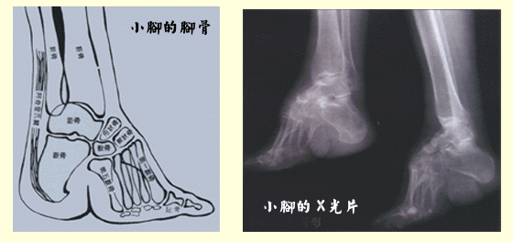
Status of Women

Slide 12
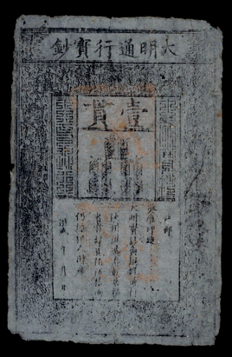
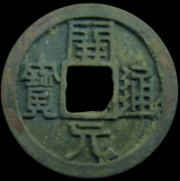
Economic Achievements: Expanded Trade
Foreign trade expands under both dynasties
Chinese merchants trade with India, Persia, and the Middle East
Chinese become expert shipbuilders and emerge as a naval power
To improve trade, the government issued paper money—the world’s first

Slide 13
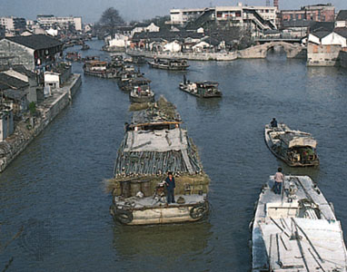
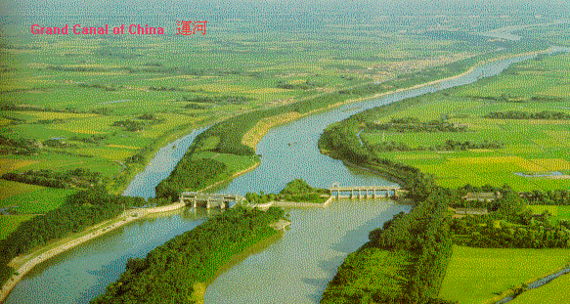
Economic Achievements: Canals
Canals were built to encourage trade and improve transportation
Grand Canal was the largest linking the Huang He and Yangzi Rivers
  Allows food from farms in southern China to be sent north

Slide 14
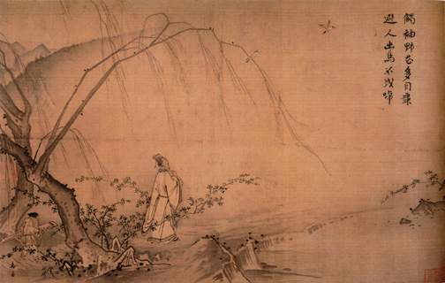
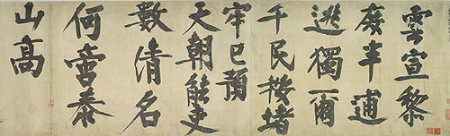
Contributions: Inventions, Literature, and the Arts
Arts and writing are highly valued
Chinese landscape painting becomes popular during the Song period
Calligraphy (fine handwriting) flourished

Slide 15
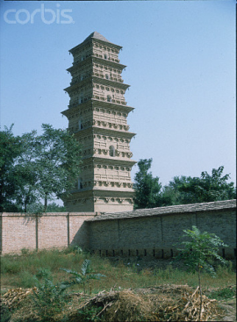
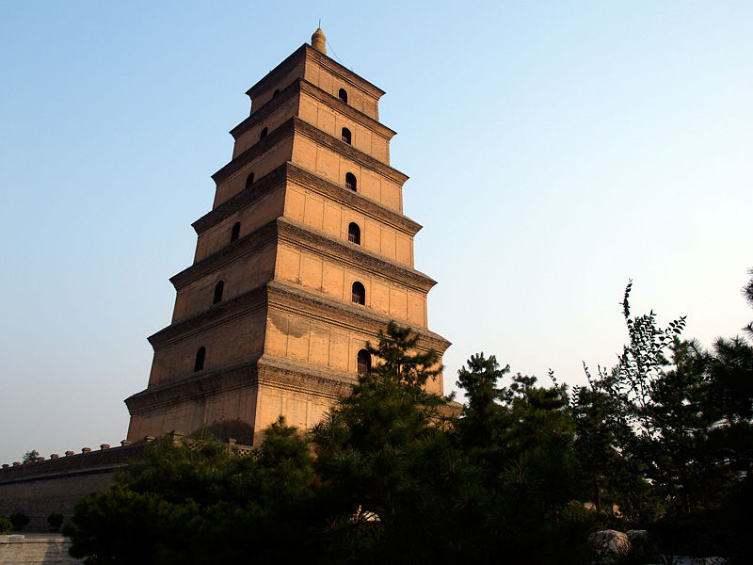
Contributions: Inventions, Literature, and the Arts
Chinese architects created the pagoda (temple with a roof that curved up at the corners)

Slide 16
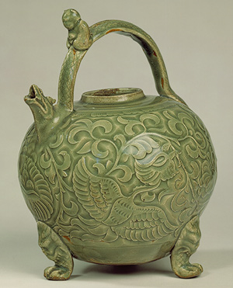
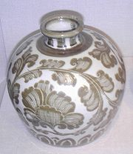
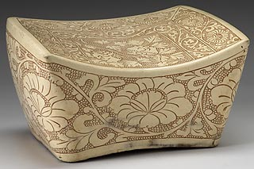
Contributions: Inventions, Literature, and the Arts
Chinese became experts at making porcelain (hard, shiny pottery)

Slide 17
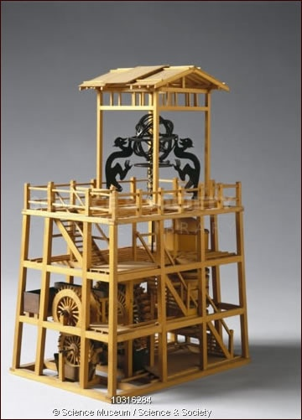
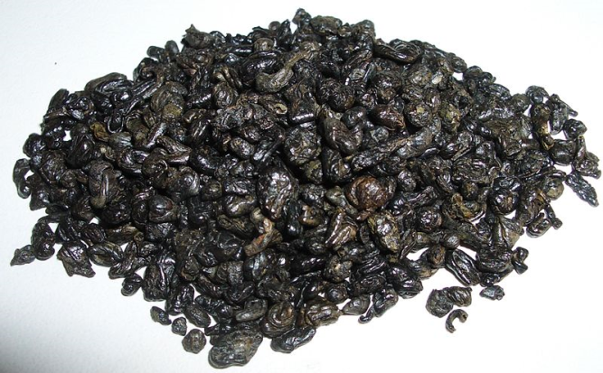
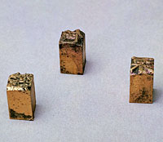
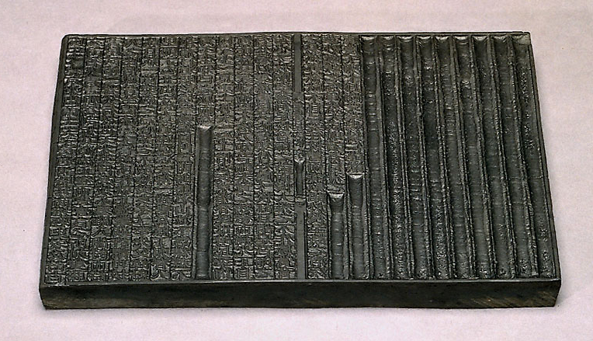
Contributions: Inventions, Literature, and the Arts
Inventions include:
mechanical clock
Gunpowder
movable type
smallpox vaccine

Slide 18
Chinese Influence on Japan
The Japanese first learned about Chinese culture through Korea
Japanese nobles bring Chinese ideas and technology back to Japan
  Adapt language, food, style of dress
When the Tang Dynasty declined, the Japanese had begun to blend Chinese ideas with their own to create a unique culture
  Japanese develop own style of art and writing

Slide 19
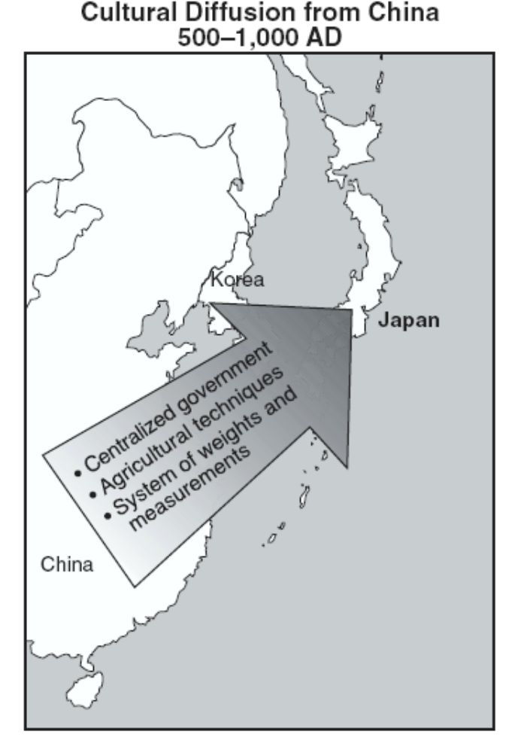
Chinese Influence on Japan

Slide 20
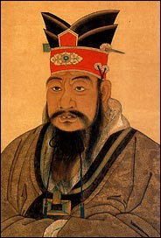
Confucianism: Founder
Originated 551 – 479 BC in China by Confucius

Slide 21
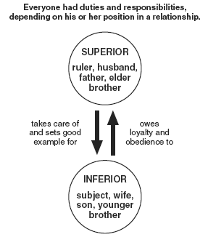
Confucianism: Beliefs
Confucianism is a philosophy as opposed to a religion
Confucianism deals mainly with living an ideal life rather than worshipping gods.
Proper conduct: everyone has duties and responsibilities to fulfill.

Slide 22
Confucianism: Beliefs
Respect for parents (filial piety), ancestors, teachers, and rulers (rulers must also respect their subjects).
Do nothing that you would not want other to do to you.
Confucianism had a strong influence on government in China.
Government positions were given to Confucian scholars—civil service.

Slide 23
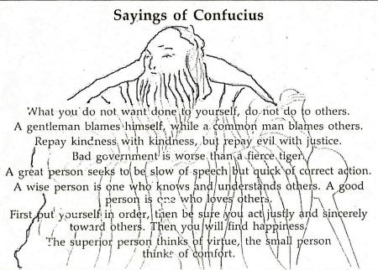
Confucianism: Beliefs
Confucianism also helped relax the rigid class structure in China by emphasizing human conduct rather than rank.
Confucius believed social order comes from respect, kind acts, and generosity.

Slide 24
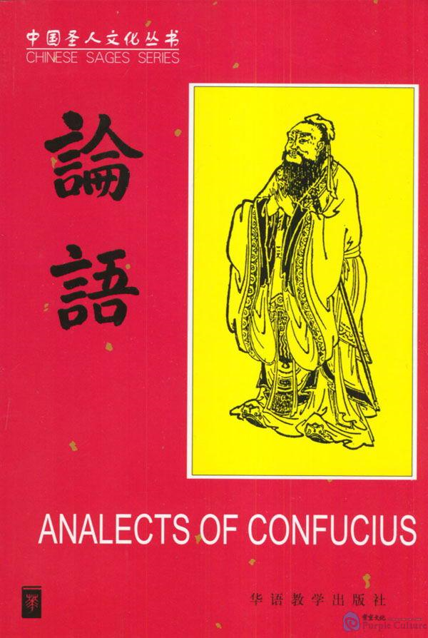
Confucianism: Sacred Text
Analects-ideas of Confucius gathered by his students
  A guide to ethical principles of behavior, moral judgments, and social order.

Slide 25
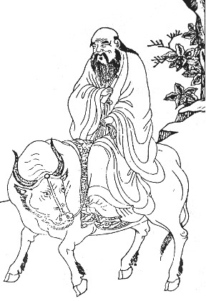
Taoism (Daoism): Founder
Laozi (He lived at the same time as Confucius)

Slide 26


Taoism (Daoism): Beliefs
“tao” = the right way to live.
Taoism emphasizes finding inner peace by living simply and in harmony with nature.
Taoists also believe that government is unnatural and we are better off with as little government as possible.

Slide 27
Taoism (Daoism): Sacred Text
The Way of Virtue—Laozi is believed to be the author
Zhuang-zi—(written several centuries later) fables, sayings, and dialogues

Slide 28
Questions to Study
Why are the Tang and Song Dynasties referred to as a golden age?
In what ways did Chinese culture affect the cultures of Korea and Japan?
What role did women play in the Tang and Song dynasties?

Slide 29
Practice!
According to the map, which conclusion about China during the Tang and Song dynasties is accurate?
Most trade routes began in Beijing.
China’s overland trade routes connected China to Japan
The areas under the control of these dynasties did not change.
China traded extensively with other nations and regions.

Slide 30
Practice!
Block printing, gunpowder, and the abacus were developed.
The compass was discovered and used to improve the determination of direction when sailing.
These advances are associated with the
Tang and Sung dynasties of China
Gupta Empire in India
Ghana and Mali civilizations of Africa
Byzantine Empire in the Middle East

Slide 31
Practice!
The Age of Pericles in Athens, the Gupta Empire in India, and the Tang dynasty in China all experienced a golden age with
Advancements in the principles of democratic governments
Outstanding contributions in the arts and sciences
The end of foreign domination
The furthest expansion of their borders

Slide 32
Practice!
The Tang dynasty of China, the Gupta Empire of India, and the Mali Empire of Africa were similar in that each experienced a period of
Prosperity and artistic creativity
Feudalism and oppression
War and constant invasion
Mercantilism and industrial expansion

Slide 33
Practice!
The Tang Dynasty in China, the Gupta Empire in India, and the city-state of Athens in Greece during their golden ages were known as eras of
Major industrial development
Intense nationalism
Economic poverty and political upheaval
Artistic and intellectual achievement

Slide 34
Practice!
One way in which the Five Relationships, the Ten Commandments, and the Eightfold Path are similar is that they
Promoted polytheism
Establish gender equality
Provide codes of behavior
Describe secularism

Slide 35
Practice !
Showing respect for parents
Maintaining family honor
Honoring all elders
Which term is most closely related to these three actions?
Nirvana
Animism
Filial piety
Hadj (Hajj)

Slide 36
Practice!
The five relationships taught by Confucius encouraged people to
Improve their position in life
Maintain social and political order
Respect and worship nature
Serve the needs of religious leaders

